Slide 1
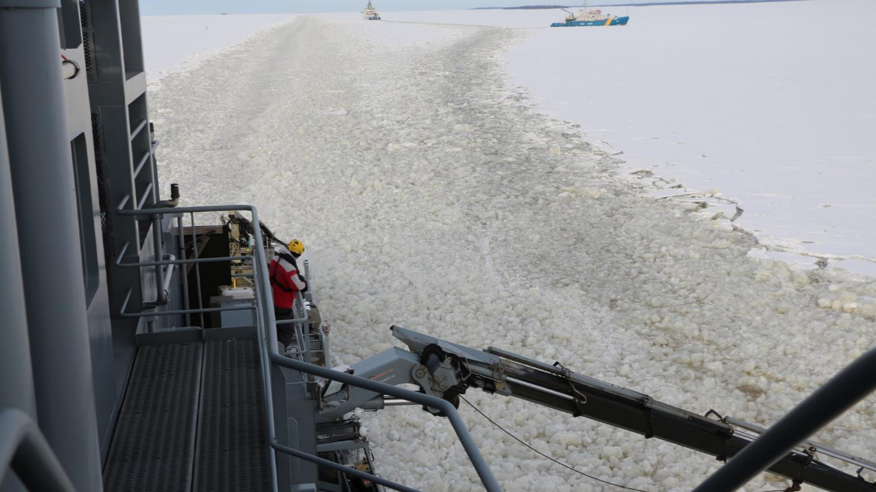
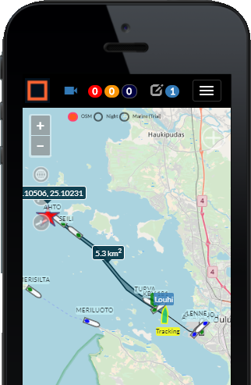
Summary of Fleetrange Situational picture in the MOSPA 2018 International Oil Spill Exercise 7-8 March Oulu, Finland

Slide 2
Scenario
MT Finter with cargo of heavy fuel oil sailing towards the Port of Oulu has collided with an underwater rock close to the Kutumatala shallow early morning on 1st of March. As a result, two starboard oil tanks were damaged, leading to oil outflow into the ice channel filled with ice floe and slush. First estimate of the amount of spilled oil is between 2000-3000 tons. The thickness of the surrounding ice field varied between 40-50 cm. SYKE duty officer was alerted to the case by MRCC Turku, and started alerting oil recovery vessels to the site. Ice breaker Ahto and multipurpose vessel Seili participate “virtually” in the exercise, while Louhi of the Finnish Navy, Turva of the Finnish Border Guard and KBV 181 of the Swedish Coast Guard will be practicing and testing their recovery gear near Oulu on March 7th.
Sentinel-1 © Copernicus data (2018)

Slide 3
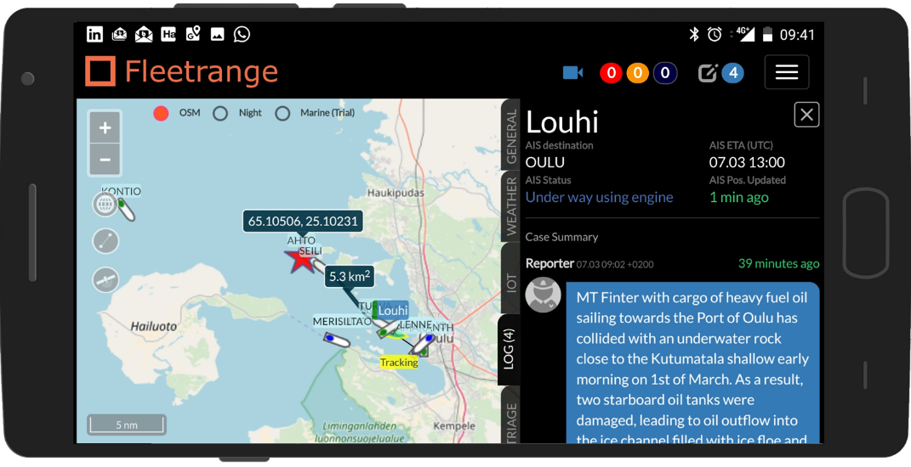
The core idea is to share
The core idea in Fleetrange is to enable easy sharing of information in exercises and real-life cases and do this in device independent formats.

Slide 4
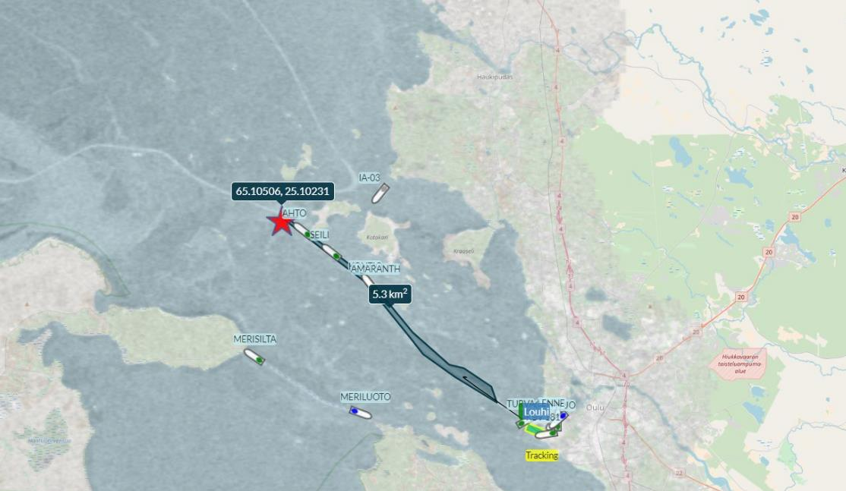
Technology - How to share situational awareness using Cloud
Utilise AIS for ship tracking
Add in tools for marking areas and locations on the map
Supplement with Sentinel-1 SAR-satellite pictures
Put everything in context and on the map
Add in a Case log and Chat
Do all this in the Cloud and create a device independent web-app
Share the picture via simple www-links to everyone
Access with Mobile, iPad, Laptop or big screen

Slide 5
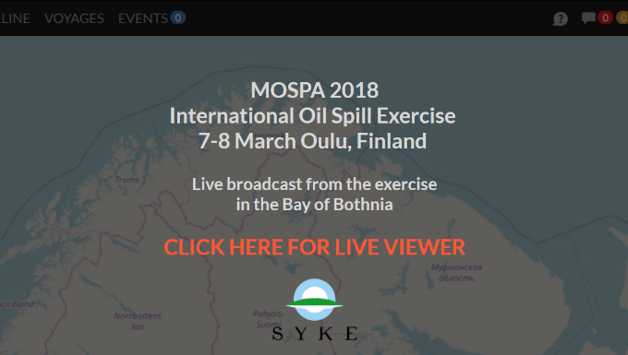
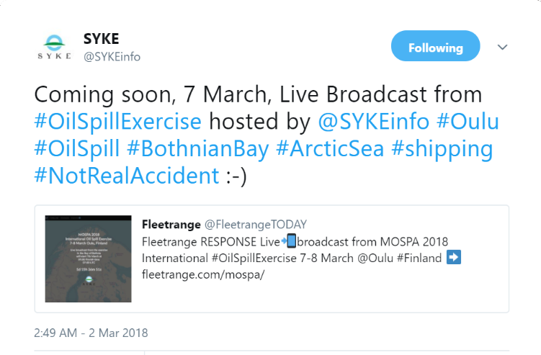
All starts with a Landing-page and Twitter
The Landing-page is published a week in advance to let observers get acquainted with the idea of a shared and easily accessible situational picture.
Twitter and other Social Media channels are used to tell everyone about the event and the option to follow it LIVE.

Slide 6
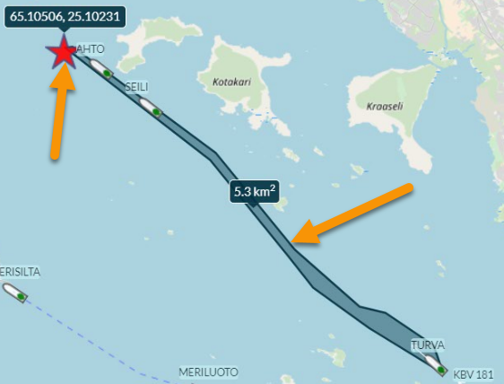
Then some preparations
We added in two virtual ships “Ahto” and “Seili”. These were stationary during the exercise, but they could also have been simulated to be moving and operating.
These types of targets act similar to Virtual AIS AtoN’s (Aids to Navigation), which the VTS (Vessel Traffic Services) uses for displaying temporary or virtual AIS-targets
We also added in the Accident-location (Red star) and the estimated oil spill area. These are added to the system as standard geojson-objects and anyone can also download the object directly from the Case log

Slide 7
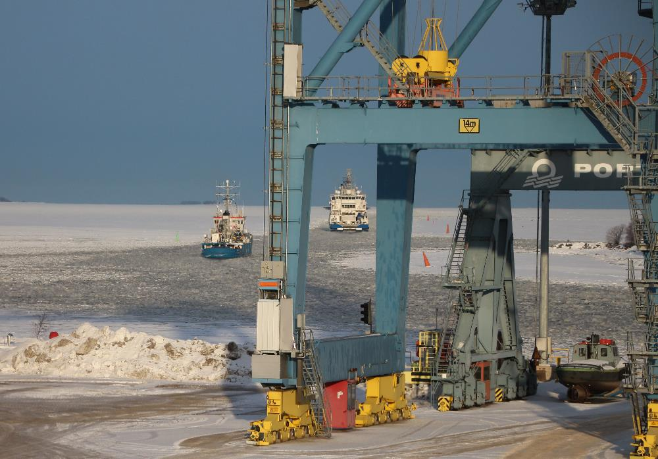
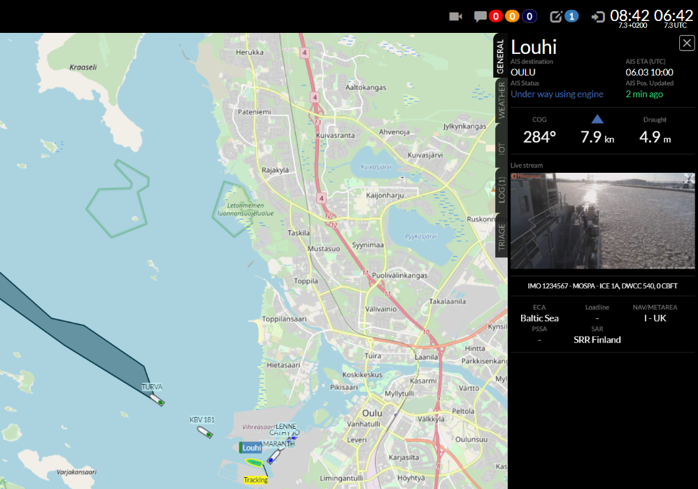
Exercise starts
Louhi, KBV 181 and Turva depart from the Port of Oulu towards the exercise area

Slide 8
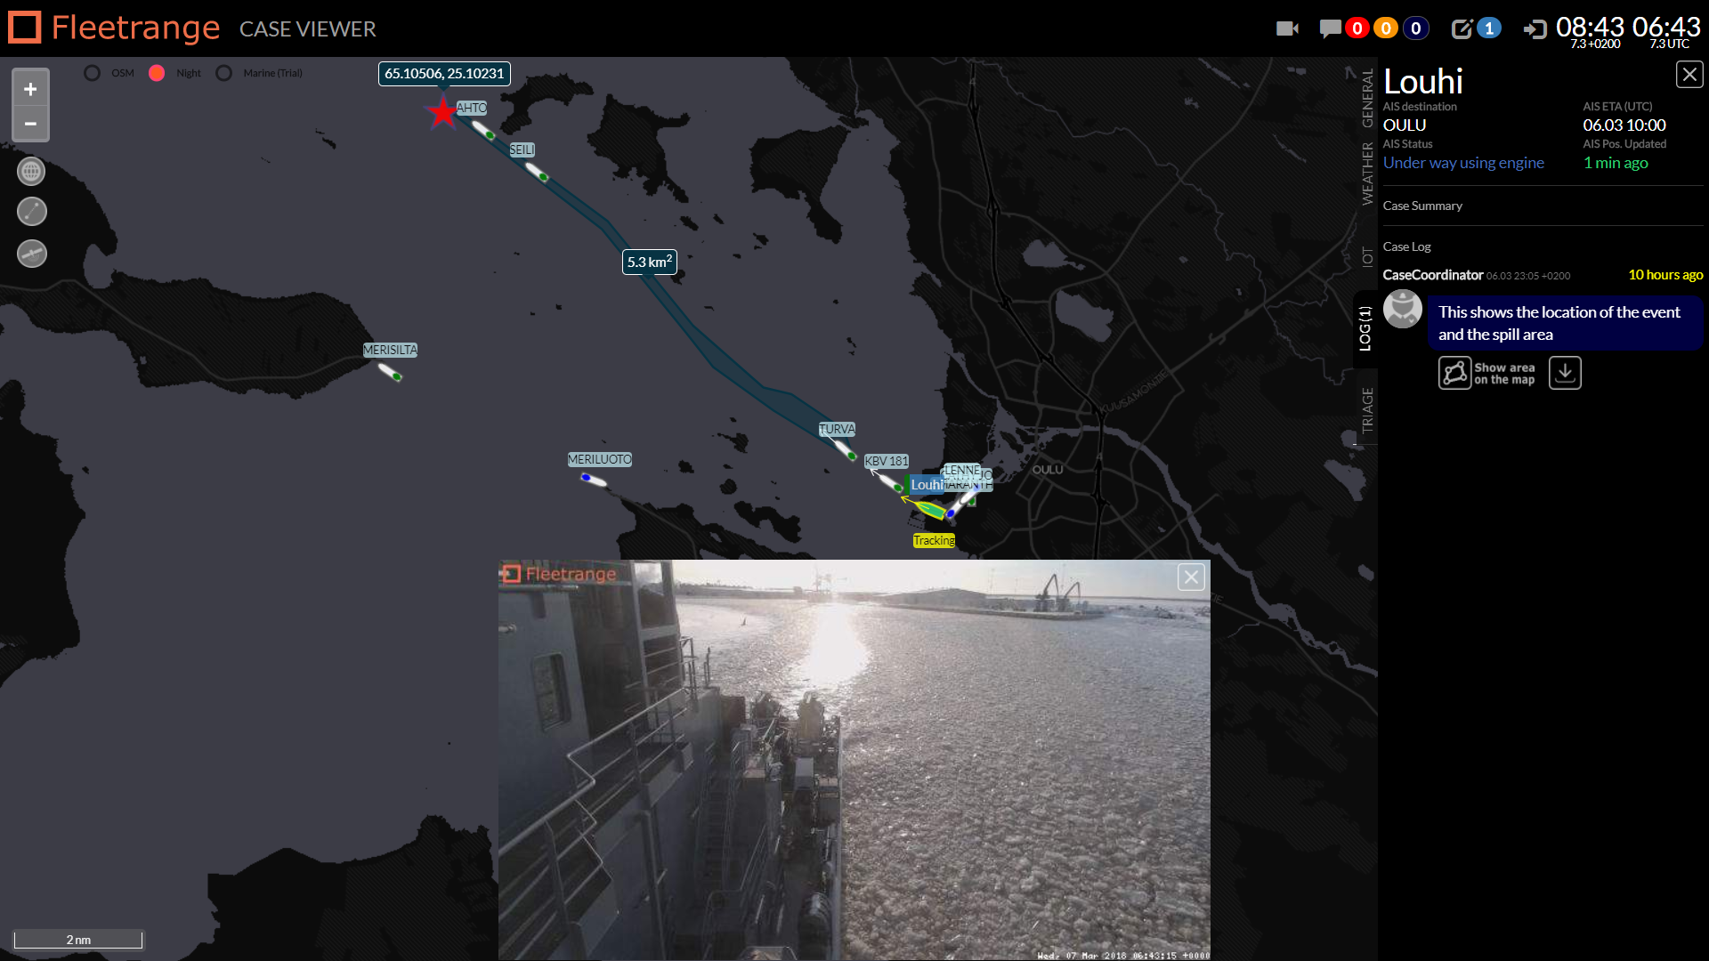
Off we go!
Louhi is equipped with IoT technology and a camera to give the viewer a better “feeling” about the conditions
The Case log describes the main event in short text format

Slide 9
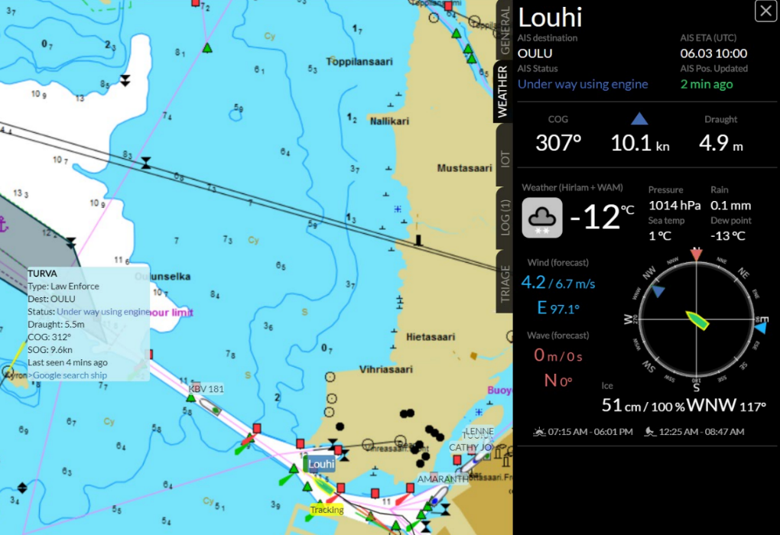
Adding more data to the picture
Users get easy access to additional information, such as weather and ice conditions
Other ship targets include also more detailed information
The case viewer features Transas nautical charts to give the User an even better understanding of the area and its characteristics

Slide 10
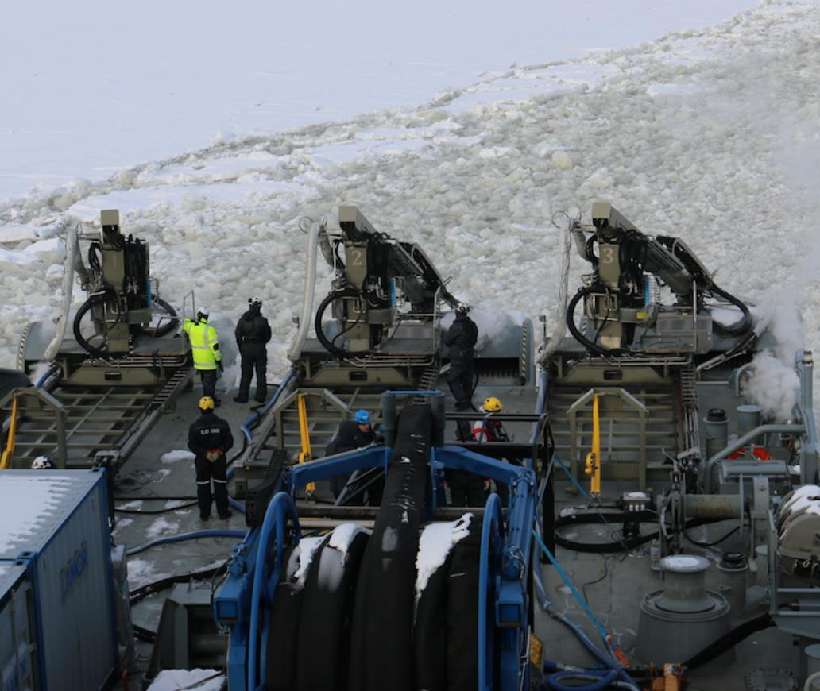
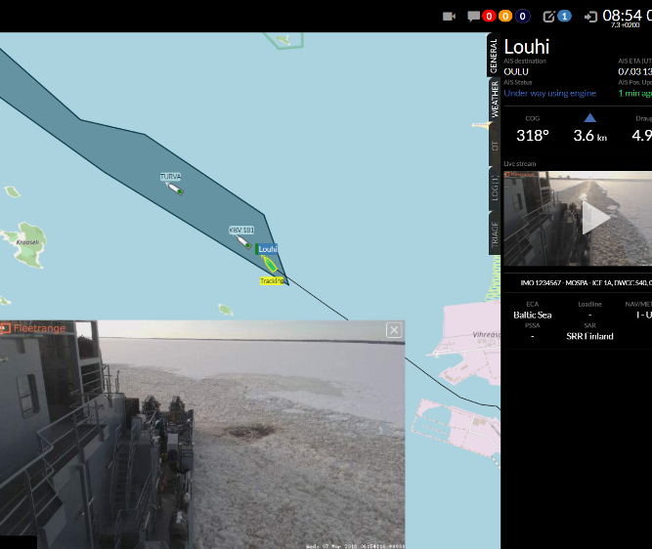
Arriving at the area
Louhi and the other ships arrive at the planned area and start to deploy the equipment

Slide 11
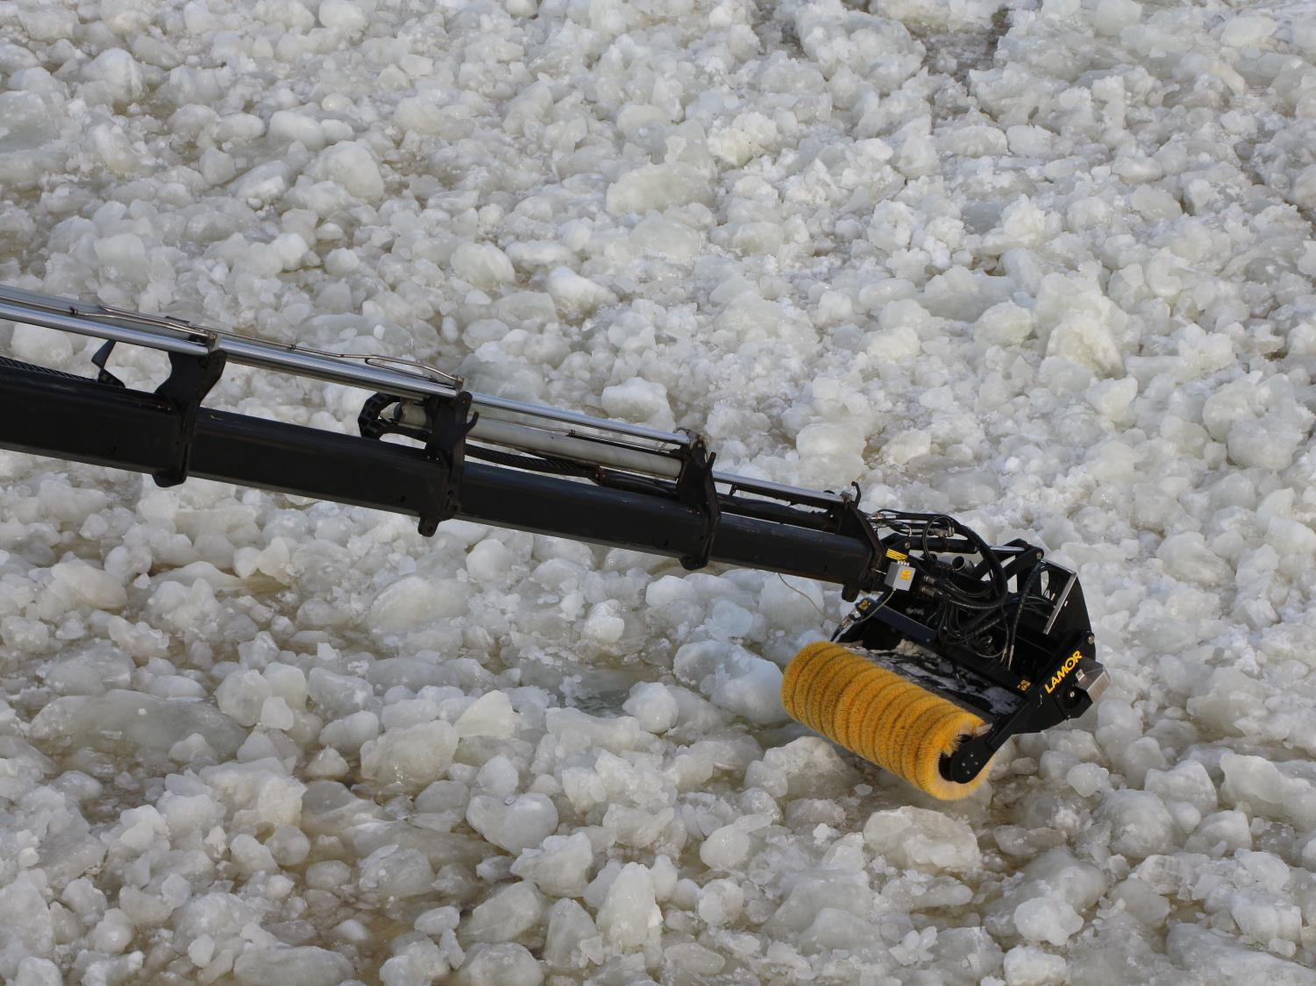
The Arctic equipment
Skimmers and brushes for the Arctic environment

Slide 12
The situational picture includes various components, such as live-video feed, various types of maps as well as Sentinel-1 SAR-satellite (Synthetic Aperture Radar) pictures

Slide 13
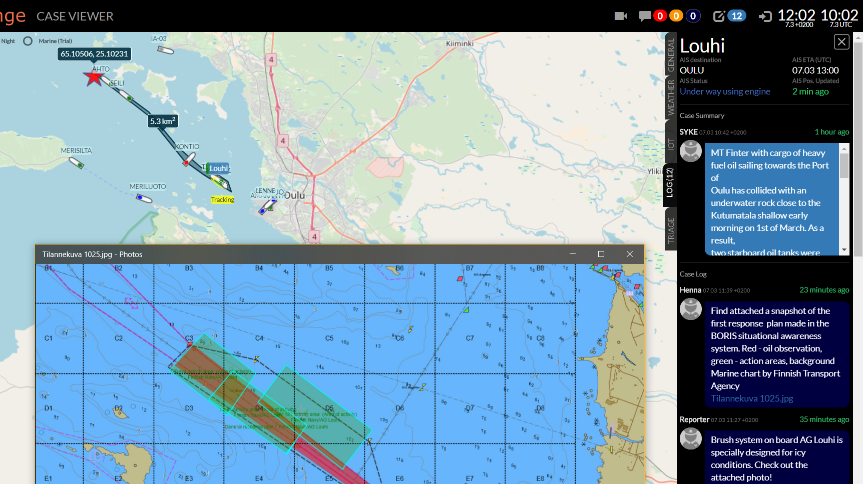
The Case log and BORIS data
The Case log is used to describe the events during the exercises
This enables a casual viewer to understand previous actions and what has happened so far
Data from SYKE’s own BORIS-situational awareness system is added to the Case log, which now includes both public and proprietary authority data

Slide 14
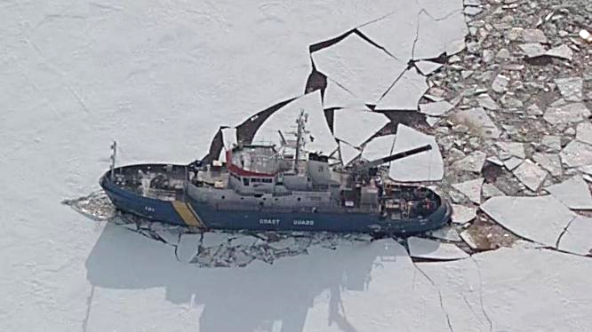
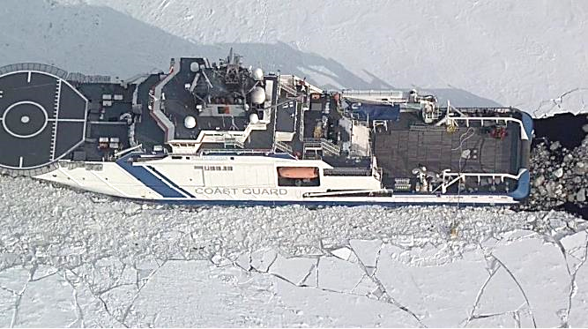
Wrapping up the exercise
Louhi
KBV 181
Turva
Finnish Border Guard made a pass over the area, shooting some really nice aerial photos of the Heros’ of this exercise

Slide 15
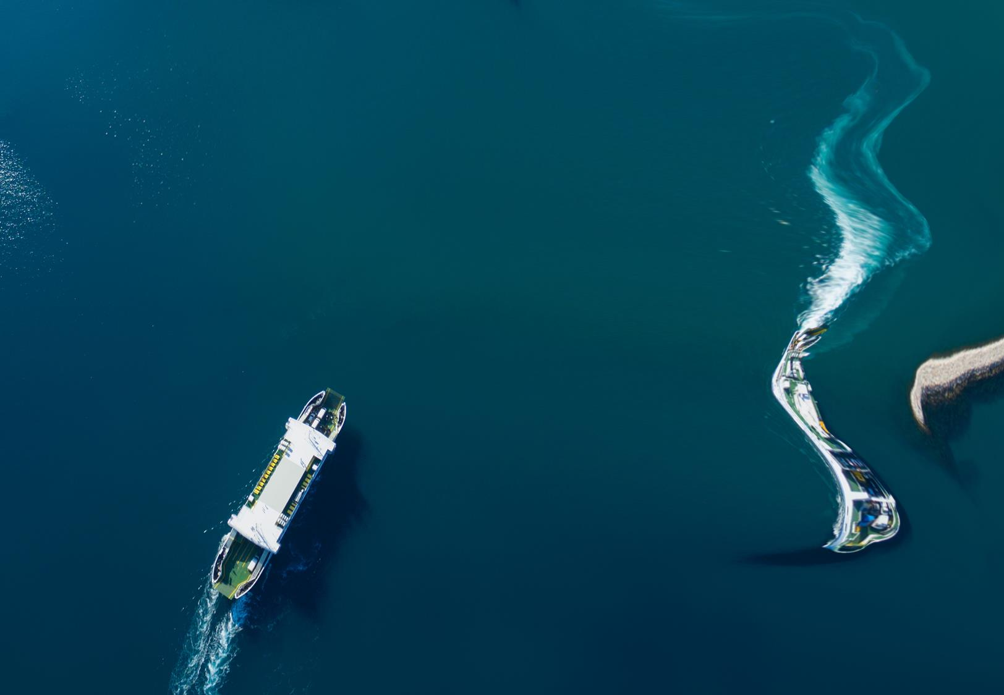
“We believe that Cloud sharing in real-life exercises and real-life cases can greatly enhance the communication between stakeholders. This speeds up things, reduces information friction and improves the overall performance of the actors.” says CEO Henrik Ramm-Schmidt.
Safety level OK
Fleetrange Ltd. Is an innovative Maritime IoT service provider specialising in real-time operational awareness solutions; Built on Simple, Intelligent and Affordable IoT and Cloud technology.
Fleetrange Ltd. +358 400 269199
Helsinki - Finland sales@fleetrange.com
VAT: FI27908043 www.fleetrange.com

